Slide 1
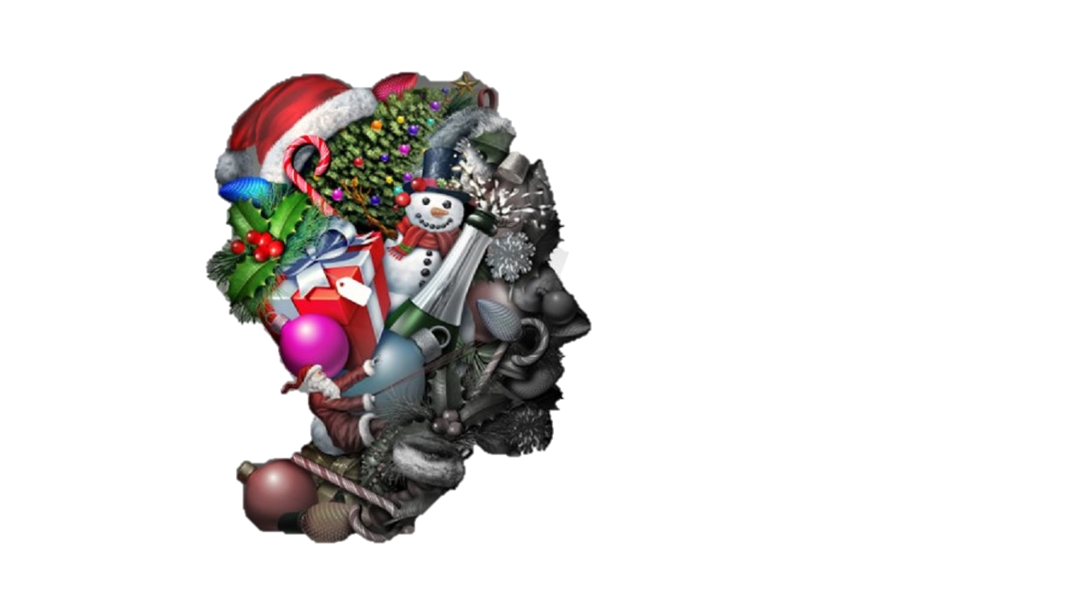

Don't “Should" on Yourself
Tips and Tricks to Help set Boundaries
Holiday Help Guide
Katelyn Filice, MACP, RP (Qualifying)

Slide 2
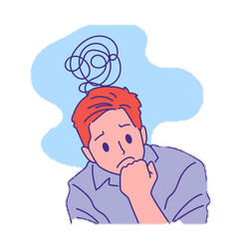
Shoulding Yourself?
“Should Statements”
  characterized by imposing fixed ‘rules’ on how the self, others, and the world should operate, coupled with overestimations of how awful it would be if these expectations are not met. Terms such as “should”, “must”, and “ought to” often appear in this style of thinking.
Common outcomes include feelings of increased:
  Anxiety
  Depressed mood
  Shame
  Guilt
  Anger
  Frustration

Slide 3

Therapeutic Tools for Addressing the Shoulds
Decentering: Increasing awareness; labeling the process present in the thinking rather than engaging with the content.
Cognitive Restructuring: Self-monitoring; consider the evidence supporting the “should” statements and reflect on whether these are helpful judgments.
Cost-Benefit Analysis: What are the pros and cons of thinking this way?
Changing the Terms: Experiment with substituting words like “should” or “must” with more flexible terms like “prefer” or “wish”. Perception is powerful.
Setting and Maintaining Personal Boundaries

Slide 4

What are boundaries?
https://www.youtube.com/watch?v=pC5FtPX6Ngg

Slide 5
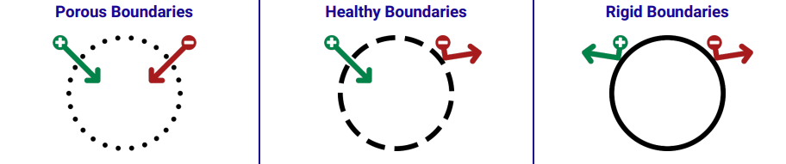
Difficulty saying “No” to others
Avoids conflict by giving in to others
Does not asset personal values
Communicates passively
Able to say “No” when needed
Accepts Conflict as normal part of life
Stands by personal values, but accepts others
Communicates assertively
Says “No” most of the time
Avoids conflict by pushing others away
Has inflexible personal values
Communicates aggressively

Slide 6
Guidelines for Setting Consequences
Actions you are willing to take.
May allow for gradual change.
May be negotiable rather than rigid lines in the sand.

Slide 7
Situational Examples of Setting Healthy Boundaries
Anger
- "You may not continue to yell at me. If you do, I will leave the room and end this interaction."
Buying Time
- "I have a policy of not making snap decisions. I need time to think and reflect on what I want to do. If you need an immediate answer it will be no."
Criticism
"It's not okay with me for you to make comments about my weight/appearance/ etc. Please stop. If you don't I won't be able to continue this conversation."
Extra Commitments
Money
"Although this is an important matter to me, I must decline your request for my help at this time.” Or “I need to honor my needs or my families needs first."
"I won't be lending you any more money. I care about you but you need to start taking responsibility for yourself."

Slide 8
Setting Boundaries for Yourself
Acknowledge Your Feelings
Experiencing loss this year or grieving, its okay to feel sad. You’re human and this period will not last forever.
Plan Ahead
Make a schedule for shopping, cooking and/or other activities. Sticking to a schedule and budget, you’re less likely to feel overwhelmed.
Embrace New Traditions
As families/ relationships grow and change so do holidays/ everyday encounters. Be open to parting with traditions or things that cause you stress or that you no longer connect with, and create new memories and celebrate in different ways.
Say No
Ask for Help
If you’re feeling sadness, trouble sleeping or anxiety despite your best efforts, talk to your doctor, seek mental health services, don’t be afraid to ask for support.
Learn to let go of Family Guilt
Not everyone has the same close relationships with their families. Sometimes those relationships can cause deep stress. If you feel you need to limit time spent
You don’t have to participate in every activity or gathering you’re invited to, especially if it impacts your mental health. It’s okay to prioritize your well-being over pleasing others, even those close to you.

Slide 9
Components of Self-Care
Physical Self-Care
Psychological & Emotional Self-Care
Social Self-Care
Spiritual Self-Care
Professional Self-Care
Self-Care
Activities that bring YOU enjoyment
Activities that take care of YOU
Activities that prioritize YOU
Activities that help YOU reach YOUR goals
Activities that protect/ align with YOUR boundaries
Activities YOU can make long-term healthy habits

Slide 10


Thank you!!
Where You can Reach Us for More Support
Behavioural Sciences Centre
  Phone: (807) 623-7677
  300 N Lillie Street

